Slide 1
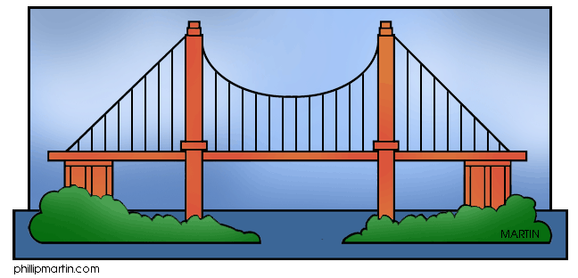
CS 118: Bridges/Switches
Interconnecting Data Links
without routers
ETHERNET 1
ETHERNET 2

Slide 2
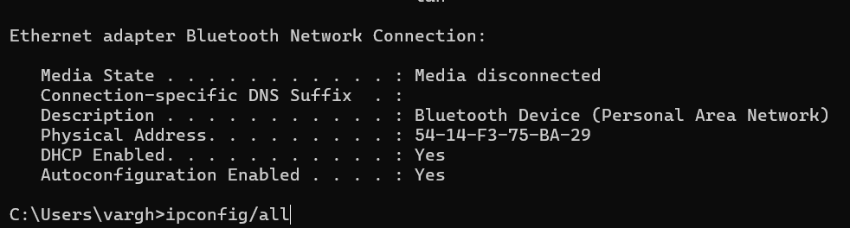
What is your MAC address?
On Windows MAC type in cmd > ipconfig/all
On MAC’s and MAC books go to Google and see how its done. System Settings→ Network→ Ethernet/WIFI → Advanced → Hardware
Mine is 54-14-F3-75-BA-29. Each pair of hex digits between dashes represents 4 bits. How many bits total?
IP (Network Layers) addresses are like 128.55.1.2. Write each number between dots in 8 bits and discard dots
IP addresses change wherever you go. Not MAC address!

Slide 3
Plan of Lecture
Review what Gigabit Ethernet is and 802.11
Understand the structure of Ethernet addresses (srill used today when you have a MAC address)
Then move on to how to interconnect Ethernets at the Data Link level (same as switches in Gigabit Ethernet). Not a router. Something in between! What is it?

Slide 4
From hubs to bridges/switches
R
S
A
•
•
HUB
HUB
B
If A talks to R at same time as B talks to S there is
a collision. True for 10 and 100 M Ethernet.
A
S
T
B
•
•
BRIDGE/SWITCH
A can talk to B at same time as S talks to T with
no collision. Bridge buffers and allows A to talk
to S after contending on two Ethernets.

Slide 5
WHY MULTICAST : Autoconfiguration,Efficiency
High−order bit of DA = 1 for multicast
SOLICITATION
Server
Clients
ADVERTISEMENT
Server
Clients
FREE COPIES (a drug!)
TO ANY SERVER
TO ANY CLIENT
TO ALL CLIENTS
Multicast generalizes broadcasting (sending to all) by sending to a subset of stations

Slide 6
MAC or Physical Addresses
6 byte Ethernet Addresses assigned by 802 committee. Vendors buy a fixed 3 byte code. They can then assign remaining 3 bytes (for Dest Addresses) or 2 bytes (for 5-byte type fields). Can buy more codes. Bottom line: every Ethernet interface has a unique MAC address, unlike IP address
Multicast address denoted by Most Significant Bit. Get 2²⁴ multicast and unicast address and 2¹⁶ types/block.
Common multicast addresses (i.e., all IP endnodes, all IP routers) and type fields are standardized.
Broadcast address is all 1’s. Multicast better. Ethernet hardware should only pass up to software packets with DA = My address or a multicast that station listens to. Hashing or CAMs. .

Slide 7
Local Area Networks Review
Till last lecture, all the physical links we studied were a single wire with one sender and one receiver. A local area network (LAN) is like a shared wire with multiple senders and multiple receivers.
Common LANs are Ethernet and token ring. In Ethernet, stations transmit when they want to; if two or more transmit at same time, there is a collision and they retransmit. Token rings when station has token
Ethernets were successful but had limitations. Hence the need for bridging to “extend” LANs.
Bridges/switches are different from hubs because they are data link relays, they store and buffer frames and relay frames, not bits..

Slide 8
Bridging:an Exercise in Invention
Problem Definition
Initial Solution
Refinements for Efficiency and Correctness.
Generalization.
Realization.

Slide 9
Problem Statement
Circa 1980 at Digital: Ethernets under attack
Ethernet had limite distance (2.5 km) and stations (8000). Also perception that Ethernet collapsed at high loads. Token ring emerging.
Question: how can we extend 2 Ethernets to make a larger Ethernet that has twice the distance, twice the bandwidth and twice the number of stations?
Repeaters don’t work as they repeat all bits everywhere. So bandwidth will not be twice. Routers work, but are expensive because we need different routers for each high-level routing protocol on the Ethernet (In next page figure, DR
= DEC Router, XR = Xerox Router. D1, D2, D3, D4 are DEC stations. X1, X2, X3, X4 are Xerox).
How can we extend LANs transparently: without end-stations knowing that they are on an extended LAN.

Slide 10
D1
D2
D3
D4
R
X1
X2
X4
X8
D1−−> D3
R | D1 | . | . | . | D3’s | Routing | Address
Data Link
Routing Header
D1
D2
D3
D4
DR
X1
X2
XR
X4
X8

Slide 11
C
Bridge
A
A C
B
Want to let A talk to C. What
Should bridge do?
SIMPLEST: FRAME REPEATER

Slide 12
C
A B
Bridge
A
A B
B
Want to let A talk to B. What
Should bridge do? Can we do
Better?

Slide 13
C
Bridge
A, B
C
A
A B
B
Want to let A talk to B. What
Should bridge do?
Filter based on database

Slide 14
C
Bridge
A
A B
B
What if A sends to C?
Manual is error prone

Slide 15
How to build database?
Manually?

Slide 16
C
Bridge
A, B
C
A
A B
B
How to build database
automatically?

Slide 17
BREAKOUT

Slide 18
Learn based on source
Address and forward
Based on destination
Address and send to other
Interface when no info is
Known (flooding)

Slide 19
Generalizations
Any LAN or Data Link that puts both source and destination addresses in frames (includes all 802 LANs)
Any topology without cycles.
More than two bridge ports.

Slide 20
Code
ReceiveFrame F on port X
AddTable(F.Source, X) (* learn source, refresh timer *)
Y = Lookup (F.Dest) (* lookup destination *)
If (Y = Nil) then (* unknown destination *)
Forward Frame F on All Ports Y != X; (*flood*) Else if (Y != X) then
Forward Frame F on Port Y
Drop frame F
(* received on same port as source *)
Else if Y = X
(* filtering *)
TimerExpiry (E) (* timer for entry E fires *) E.port = Nil; (* reenable flooding *)

Slide 21
Bridge Terminology and Summary
Transparency, Promiscuous Receive, Flooding, Filtering
Main idea: Learn based on source addresses and forward based on destination addresses. Using flooding when there is no info, and timeout to handle stale learning information.

Slide 22
Realization
Need much higher performance than router which handles all frames addressed to it.
Need to decide whether to drop or forward frames in minimum interframe time on Ethernet, 51.2 usec on each port. Otherwise could drop some frames that need to be forwarded while examining others that have to be filtered.
First DEC implementation by Mark Kempf in 1984 technology. Achieved forwarding in min frame time with low cost (1000 dollars).
10

Slide 23
Bridge Implementation
Ethernet 1
Ethernet Chip
Lookup
Memory
Proc
Engine
Ethernet Chip
Ethernet 2
3 bus design to avoid congestion on processor bus
4 ported memory design.
Hardware binary search lookup engine. Takes
log(8000) = 13 memory accesses of 100 nsec each = 1.3 usec
Processor stays in loop after a packet interrupt servicing as many packets as arriive to reduce context switching overhead.
11

Slide 24
A D
B1
B2
A
A
A D
A
B
C
D
A D
A D
D A
A
D
A
D
B1
B2
D A
D A
A
B
C
D
D to A packet is not sent on the LAN to C on the return because now bridges know where A is. No flooding on all subsequent frames

Slide 25
Centralized Algorithm
on
on
root
1
12
d=1 on
LAN 2
on on
off
on
15
off
11
13
d=2
d=2
d=1
on
on
on
LAN 1
Root is Min ID node (in this case Bridge 1)
Other bridges finds Min port, port through which it has shortest path to root (parent), For 11 it is upper port.
Each bridge also finds the ports for which this bridge is on the shortest path between root and corresponding LAN: Designated Ports. For example, 11 and 12 have d= 2 for LAN 1, so we pick shorter ID as tiebreaker, Bridge 11 is designated bridge for LAN 1, 12 for LAN 2
Each bridge turns ON Min port and all Designated Ports. ON,OFF are software states: always receive hello and management messages on all ports. Drop data packets to/from OFF port.
13

Slide 26
Final Tree
root
1
12
d=1
11
13
d=2
15
d=2
d=1
on
To be a tree, each LAN must have a unique path to every other LAN.
Algorithm guarantees that each LAN can get to root only through designated bridge for LAN and designated bridges have unique path through their parent LAN.
14

Slide 27
Distributed Algorithm
All nodes sends hello message saying ID and current distance to root (r, d). Every node N keeps an estimate r(N), d(N) of its current estimate of root and distance
On hearing a smaller root, adopt that root and update your distance as d + 1:
On receipt of (r,d) at Node N
If (r < r(N)) then r(N) = r; d(N) = d+1;
Else if (r = r(N) and (d < d (N)) then
d(N) = d + 1;
Bridges must wait some some time after the estimates stabilize to turn ON ports and start forwarding to avoid loops
15

Slide 28
Spanning Tree Computation
1, 0
1
12
12, 0
11
13
11, 0
13, 0
1, 0
1
12
1, 1
11
13
1, 1
11, 1
1, 0
1
12
1, 1
14
12 is db
13
off
1, 1
11
1, 2, parent =11
on
11 is db

Slide 29
Conclusion
Necessity is the mother of invention.
Find new problems that matter and find creative solutions. Challenge the dogma (wire-speed)
The big ideas: auto-configuration, filtering, flooding, wire speed forwarding, spanning tree, designated bridges
Link layer relays versus physical layer relays. Next lecture: routing layer relays aka Internet routers! Why so many concepts. Will discuss next time.

Slide 30
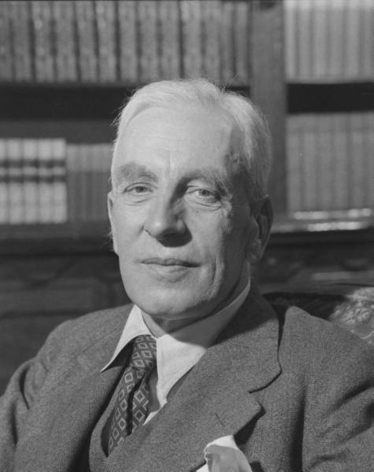
EPILOG: TOYNBEE ON CHALLENGES
Challenge-and-response' is a formula
describing the free play of forces that provokes
new departures in individual and social life.
An effective challenge stimulates men to
creative action . . .
― Arnold Toynbee.

